Slide 1
CAS AML 2022 Reinforcement Learning
Elementary Reinforcement Learning
Dr. Lorenzo Brigato
Artificial Intelligence in Health and Nutrition (AIHN) Laboratory ARTORG Center for Biomedical Engineering Research University of Bern

Slide 2
Outlook
Introducing the RL Problem
Markov Decision Processes (MDPs)
Prediction
Control
L. Brigato
Reinforcement Learning: Elementary RL

Slide 3
Introducing the Reinforcement Learning Problem
3

Slide 4
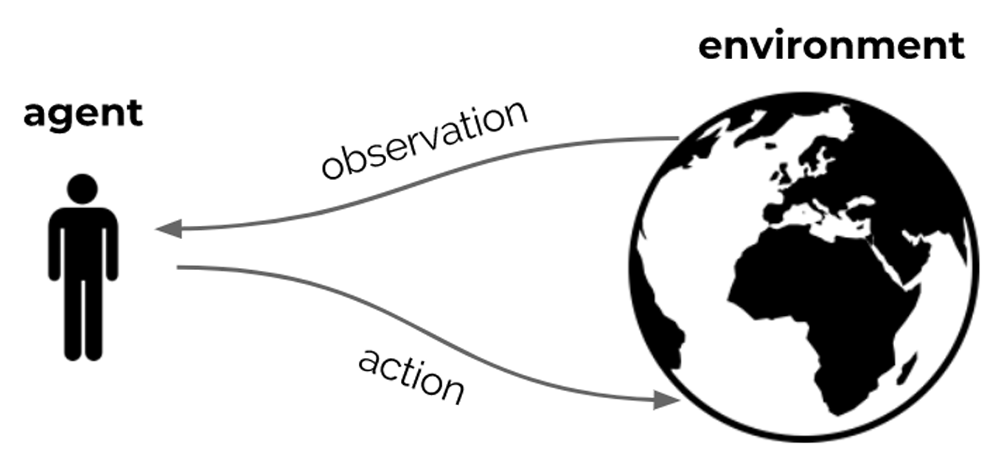
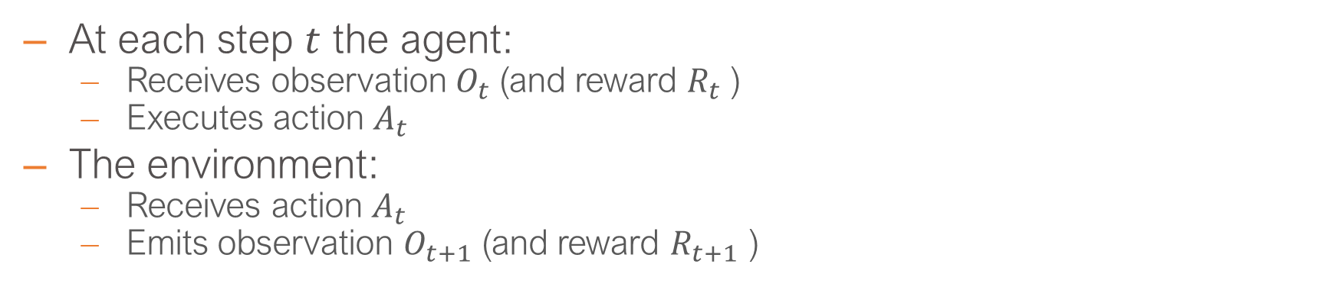
The Agent and the Environment
At each step $t$ the agent:
Receives observation$O_{t}$(and reward $R_{t}$)
Executes action $A_{t}$
The environment:
Receives action $A_{t}$
Emits observation $O_{t+1}$ (and reward $R_{t+1}$ )
[Hado van Hasselt, 2021]
L. Brigato
Reinforcement Learning: Elementary RL

Slide 5
Maximizing Value by Taking Actions
Goal: select actions to maximize total future reward
Actions may have long term consequences
Reward may be delayed
It may be better to sacrifice immediate reward to gain more long-term reward
Examples:
A financial investment (may take months to mature)
Refueling a helicopter (might prevent a crash in several hours)
Blocking opponent moves (might help winning chances many moves from now)
A mapping from states to actions is called a policy
L. Brigato
Reinforcement Learning: Elementary RL

Slide 6
Core Concepts
The RL formalism includes:
Reward signal (specifies the goal)
Environment (dynamics of the problem)
Agent, containing:
Agent state
Policy
Value function estimate (?)
Environment Model (?)
L. Brigato
Reinforcement Learning: Elementary RL

Slide 7
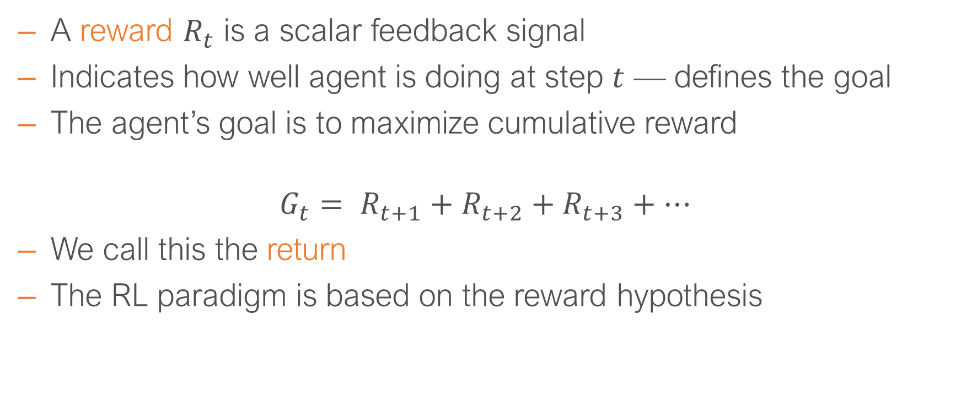
Reward
A reward $R_{t}$ is a scalar feedback signal
Indicates how well agent is doing at step $t$ — defines the goal
The agent’s goal is to maximize cumulative reward
$$G_{t}= R_{t+1}+R_{t+2}+R_{t+3}+⋯$$
We call this the return
The RL paradigm is based on the reward hypothesis
Hypothesis
Any goal can be formalized as the outcome of maximizing a cumulative reward
L. Brigato
Reinforcement Learning: Elementary RL
Notes:
Rewards is just a number. It can be positive, it can be negative (penalty). The goal is the accumulation or sum of these rewards over time. We devote a letter G, but we use the term RETURn to refer to this. Return is the sum of the rewards into the future. The return is defined by the future rewards summed together. The past rewards belong to the past and we cannot change them as we cannot the past

Slide 8
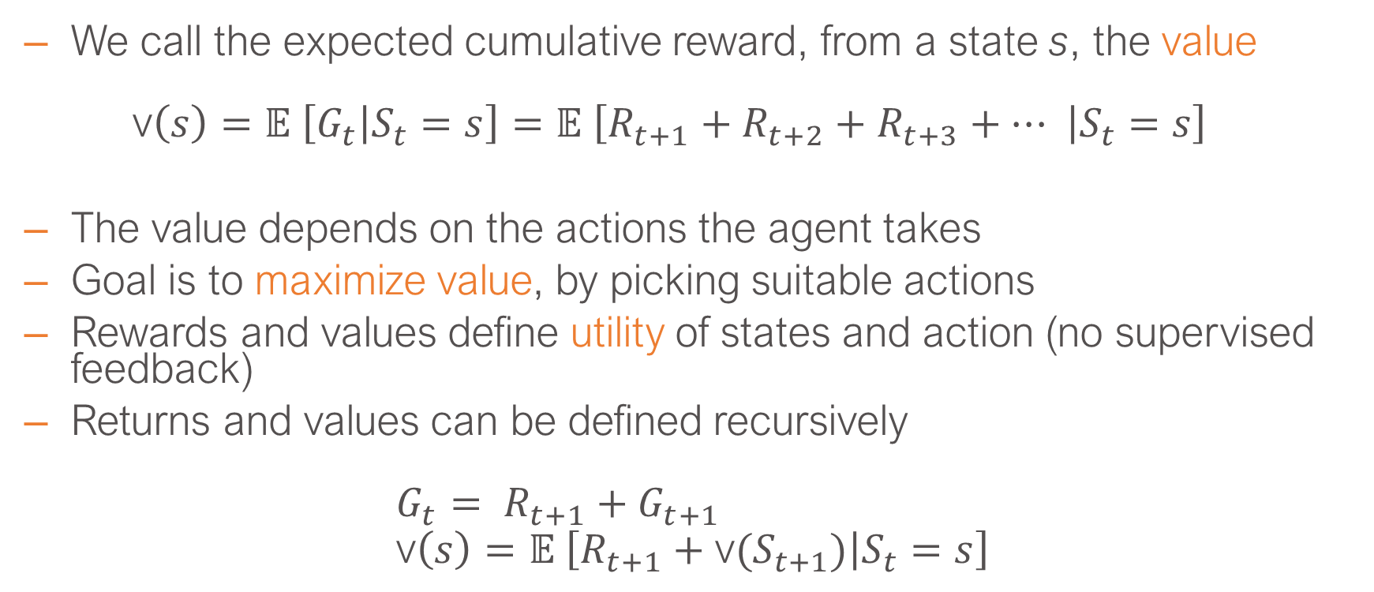
Values
We call the expected cumulative reward, from a state s, the value
$$\text{v}\left(s\right)=𝔼 \left[G_{t} | S_{t}=s\right]=𝔼 \left[R_{t+1}+R_{t+2}+R_{t+3}+⋯ | S_{t}=s\right]$$
The value depends on the actions the agent takes
Goal is to maximize value, by picking suitable actions
Rewards and values define utility of states and action (no supervised feedback)
Returns and values can be defined recursively
$$G_{t}= R_{t+1}+G_{t+1} \\ \text{v}\left(s\right)=𝔼 \left[R_{t+1}+\text{v}(S_{t+1}) | S_{t}=s\right]$$
L. Brigato
Reinforcement Learning: Elementary RL
Notes:
Then, we cannot always hope to optimise the return itself. Therefore, we can define the expected return which we call “the value”. The value at state s is the expectation of the return, thus the sum of the rewards into the future conditioned by the fact that you are in that state s. We have not defined yet what a state is, but for simplicity lets assume that it is an observation. In any case, we will explain within a moment. The value depends of the dynamics of the environment, but also the actions that the agent is taken. The goal is to maximize the value by picking action so that this value becomes large.
Conveniently, this is used by many algorithms can be defined recursively. The return at time t is the first reward plus the return from that time step t+1. Similarly, the value can be defined recursively, the valua at some state s, is the expected 1st reward that we can get after being in that stage and the value of the state that you expect to be in.

Slide 9
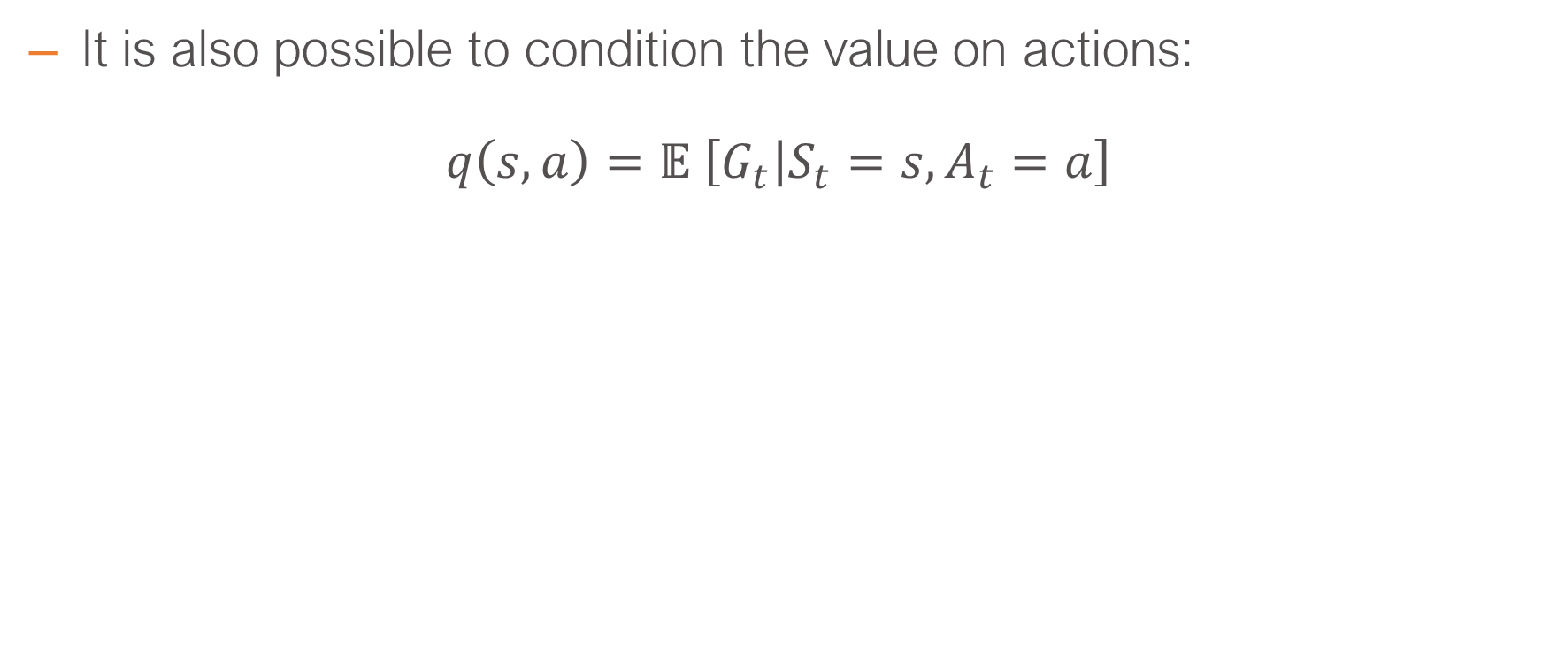
Action Values
It is also possible to condition the value on actions:
$$q\left(s,a\right)=𝔼 \left[G_{t} | S_{t}=s,A_{t}=a\right]$$
L. Brigato
Reinforcement Learning: Elementary RL
Notes:
On state and actions and this is simply defined as the expected return of being at that state and then taking that action a.

Slide 10
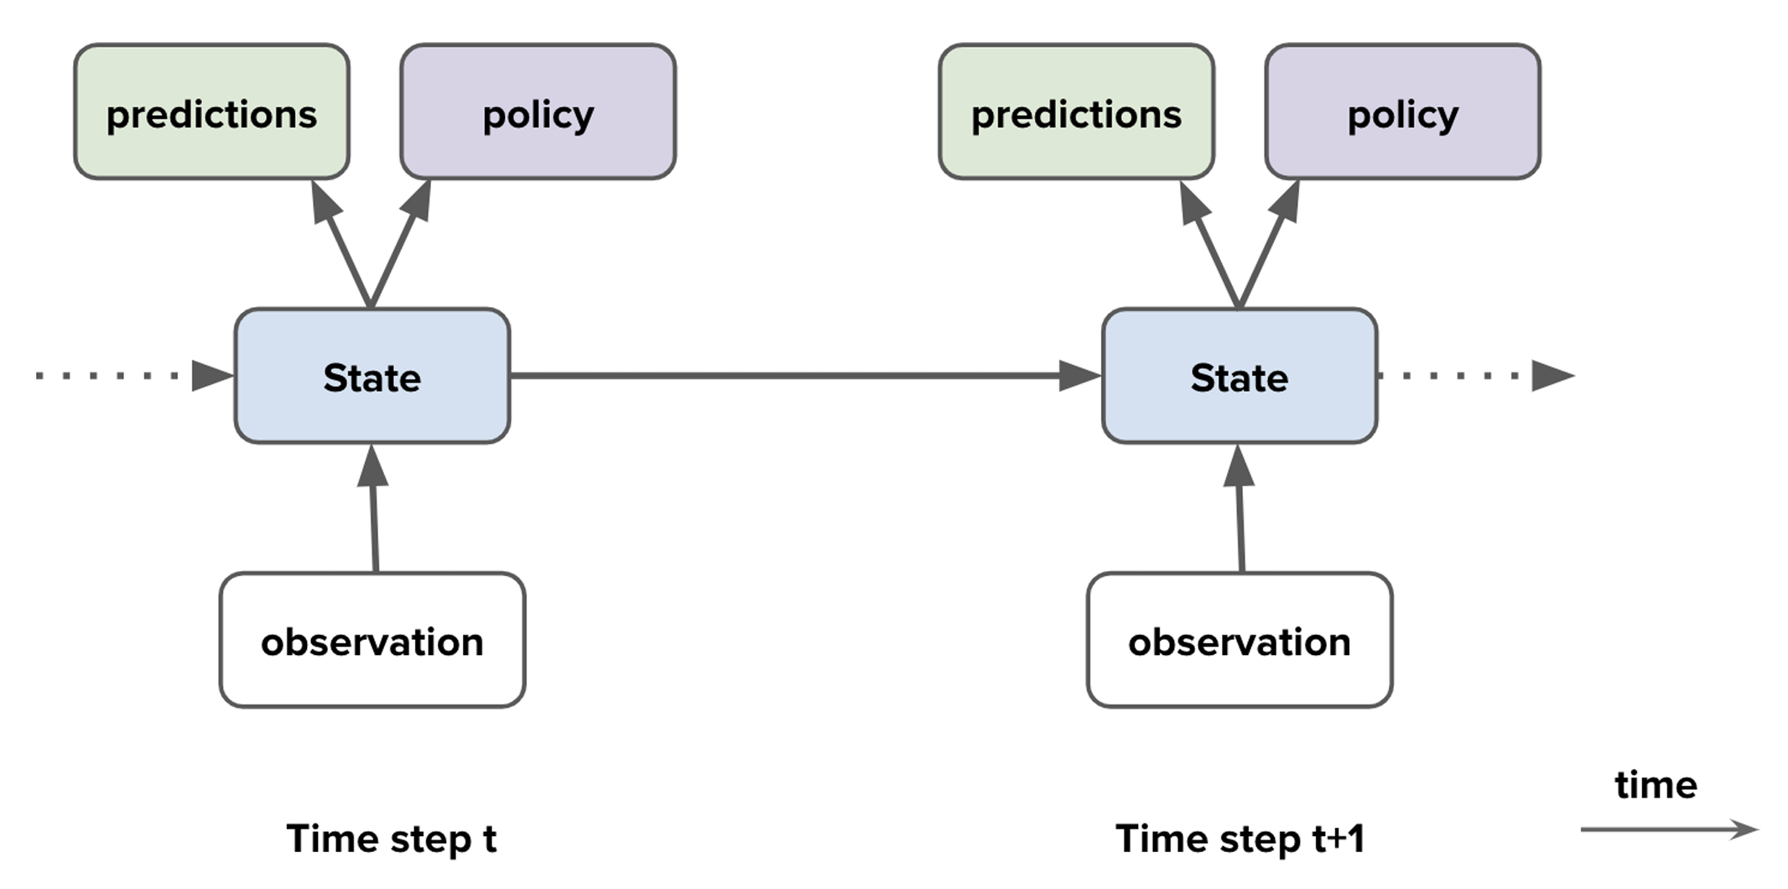
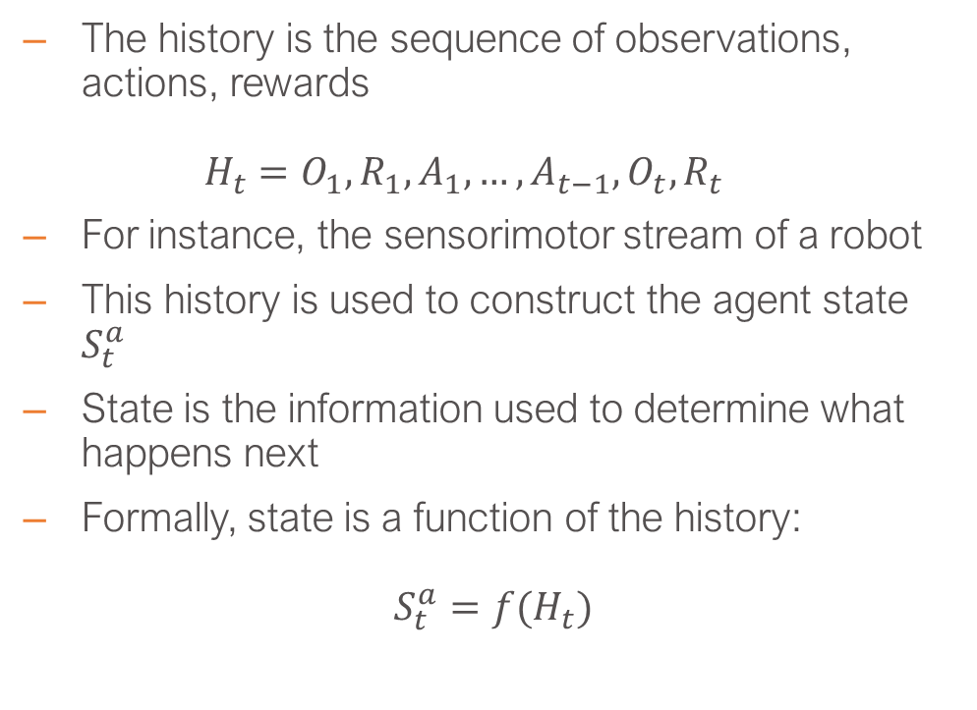
Agent State
The history is the sequence of observations, actions, rewards
$$H_{t}=O_{1},R_{1},A_{1}, …,A_{t−1},O_{t},R_{t}$$
For instance, the sensorimotor stream of a robot
This history is used to construct the agent state $S_{t}^{a}$
State is the information used to determine what happens next
Formally, state is a function of the history:
$$S_{t}^{a}={f(H}_{t})$$
[Hado van Hasselt, 2021]
L. Brigato
Reinforcement Learning: Elementary RL
Notes:
Now we are inside the agent. In the schematic diagram on the right time increments as we go to the right. There is always an observation that comes in, then there is an internal state of the agent that creates some predictions and defines a policy and then the action is selected based on the policy. An arrow from the policy to the action and then to the environment. But lets focus on the state components. State here refers to what the agent takes along him from one time to the next, e.g. memory, learned components, predictions,

Slide 11
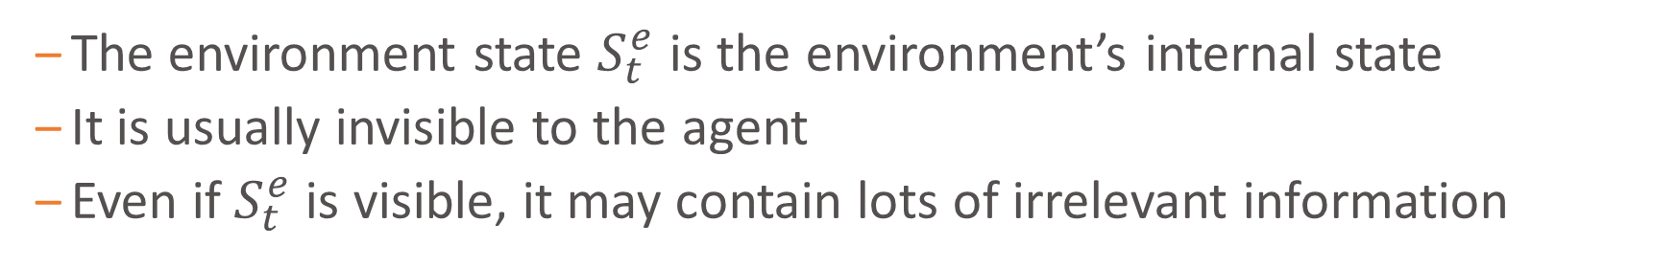
Environment State
The environment state $S_{t}^{e}$ is the environment’s internal state
It is usually invisible to the agent
Even if $S_{t}^{e}$ is visible, it may contain lots of irrelevant information
[Hado van Hasselt, 2021]
L. Brigato
Reinforcement Learning: Elementary RL
Notes:
We can talk about the environment state, which can be all the physical quantities of the world (in the case of real life applications). Is not part of the observation stream process.

Slide 12
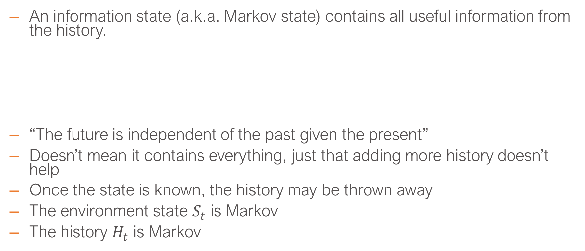
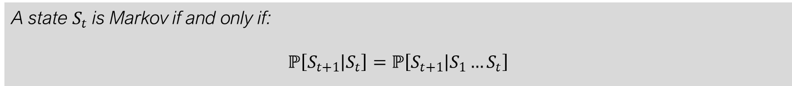
Information or Markov State
An information state (a.k.a. Markov state) contains all useful information from the history.
“The future is independent of the past given the present”
Doesn’t mean it contains everything, just that adding more history doesn’t help
Once the state is known, the history may be thrown away
The environment state $S_{t}$ is Markov
The history $H_{t}$ is Markov
Definition
A state $S_{t}$ is Markov if and only if:
$$ℙ\left[S_{t+1} | S_{t}\right]=ℙ\left[S_{t+1} | S_{1}…S_{t}\right]$$
L. Brigato
Reinforcement Learning: Elementary RL
Notes:
Important concept of RL which is the Markov property, which is used to solve decision problems. The Markov property itself states that the process is Markovian or the state is Markovian for this process if the probability of a reward and a subsequent state does not change if we add more history.
Typically the agent state is a compression of the total History Ht.

Slide 13
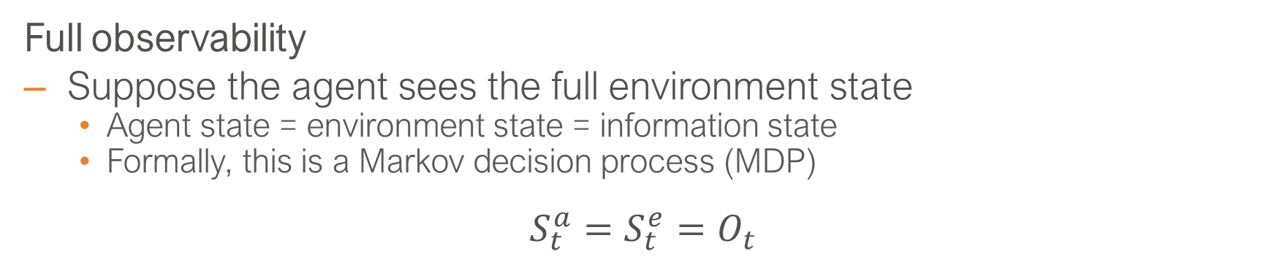
Fully Observable Environments
Full observability
Suppose the agent sees the full environment state
Agent state = environment state = information state
Formally, this is a Markov decision process (MDP)
$$S_{t}^{a}=S_{t}^{e}=O_{t}$$
[Hado van Hasselt, 2021]
L. Brigato
Reinforcement Learning: Elementary RL

Slide 14
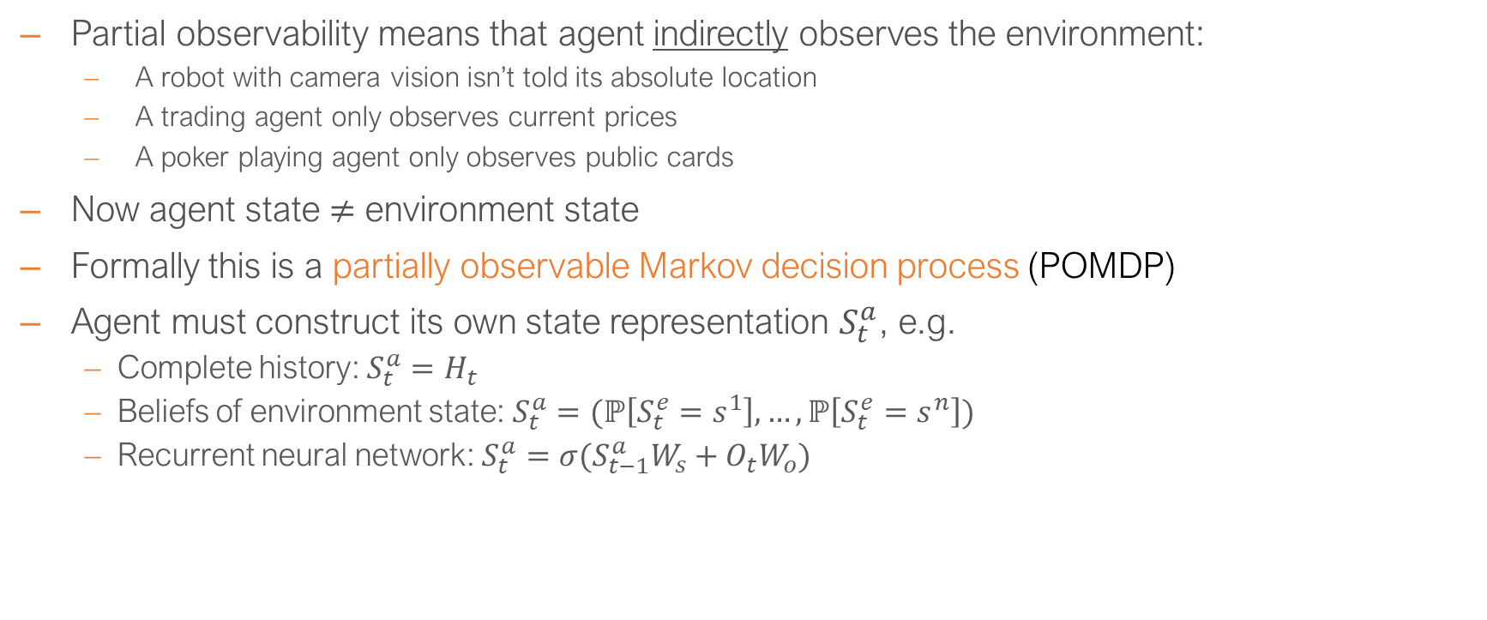
Partially Observable Environments
Partial observability means that agent indirectly observes the environment:
A robot with camera vision isn’t told its absolute location
A trading agent only observes current prices
A poker playing agent only observes public cards
Now agent state $≠$ environment state
Formally this is a partially observable Markov decision process (POMDP)
Agent must construct its own state representation $S_{t}^{a}$, e.g.
Complete history: $S_{t}^{a}=H_{t}$
Beliefs of environment state: $S_{t}^{a}=(ℙ\left[S_{t}^{e}=s^{1}\right], …,ℙ\left[S_{t}^{e}=s^{n}\right])$
Recurrent neural network: $S_{t}^{a}=σ(S_{t−1}^{a}W_{s}+O_{t}W_{o})$
L. Brigato
Reinforcement Learning: Elementary RL
Notes:
Part of the environment is hidden to the agent

Slide 15
Major Components of an RL Agent
An RL agent may include one or more of these components:
Policy: agent’s behavior function
Value function: how good is each state and/or action
Model: agent’s representation of the environment
L. Brigato
Reinforcement Learning: Elementary RL

Slide 16
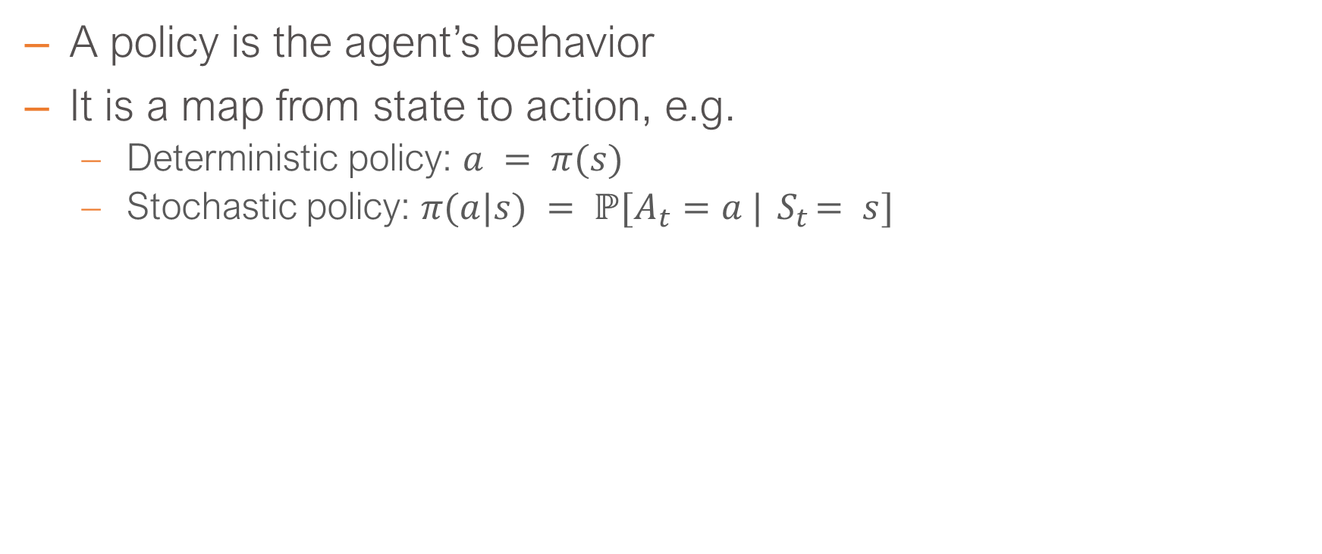
Policy
A policy is the agent’s behavior
It is a map from state to action, e.g.
Deterministic policy: $a = π(s)$
Stochastic policy: $π(a|s) = ℙ[A_{t}=a |{ S}_{t}= s]$
L. Brigato
Reinforcement Learning: Elementary RL
Notes:
As a function that takes the state and outputs an action.
Often is more useful to think about stochastic policy where the probability of a action given a state and usually policy (paei) is given by a probability discribution of actions.

Slide 17
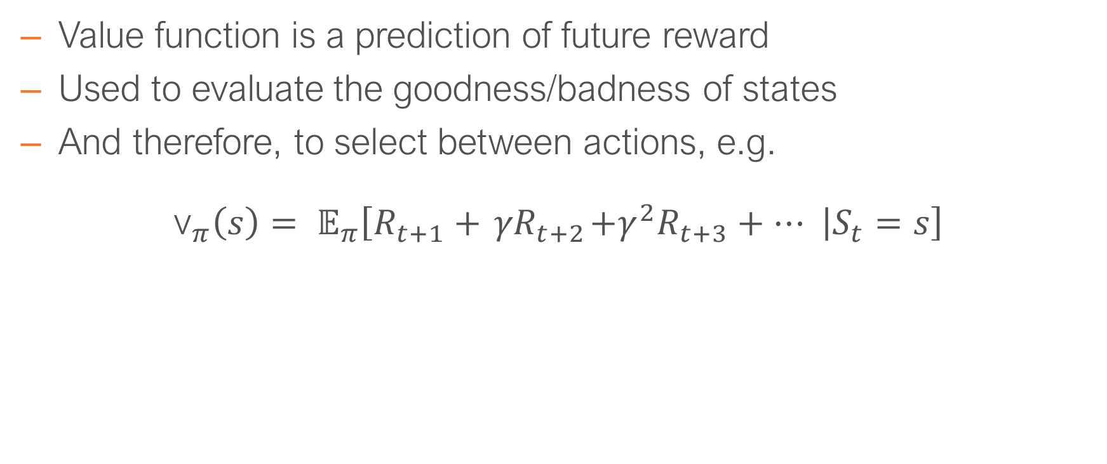
Value Function
Value function is a prediction of future reward
Used to evaluate the goodness/badness of states
And therefore, to select between actions, e.g.
$${\text{v}}_{π}\left(s\right)= 𝔼_{π}\left[R_{t+1}+{ γR}_{t+2}+γ^{2}R_{t+3}+⋯ | S_{t}=s\right]$$
L. Brigato
Reinforcement Learning: Elementary RL

Slide 18
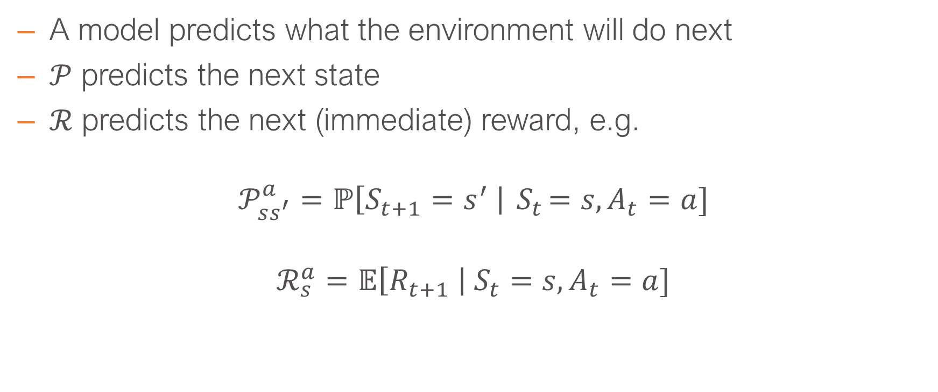
Model
A model predicts what the environment will do next
$𝒫$ predicts the next state
$ℛ$ predicts the next (immediate) reward, e.g.
$$𝒫_{ss^{′}}^{a}=ℙ\left[S_{t+1}=s^{′} \right|{ S}_{t}=s, A_{t}=a]$$
$$ℛ_{s}^{a}=𝔼\left[R_{t+1} \right| S_{t}=s, A_{t}=a]$$
L. Brigato
Reinforcement Learning: Elementary RL
Notes:
Approxiamtion of the actual probability of seeing that state after observing the previous state and action.
Condition a state and action then we can model the expected reward given that the agent is in that state and that the specific action.

Slide 19
Agent Categories (1/2)
Value Based
No Policy (Implicit)
Value Function
Policy Based
Policy
No Value Function
Actor Critic
Policy
Value Function
L. Brigato
Reinforcement Learning: Elementary RL

Slide 20
Agent Categories (2/2)
Model Free
Policy and/or Value Function
No Model
Model Based
Optionally Policy and/or Value Function
Model
L. Brigato
Reinforcement Learning: Elementary RL

Slide 21
Subproblems of the RL problem
Prediction: evaluate the future (for a given policy)
Control: optimize the future (find the best policy)
Strongly related
If we could predict everything, do we need anything else?
L. Brigato
Reinforcement Learning: Elementary RL

Slide 22
Markov Decision Processes
22

Slide 23
Introduction to MDPs
MDPs formally describe an environment for RL
Current state completely characterizes the process (fully observability)
Almost all RL problems can be formalized as MDPs, e.g.
Optimal control primarily deals with continuous MDPs
Partially observable problems can be converted into MDPs (POMDPs)
Bandits are MDPs with one state
L. Brigato
Reinforcement Learning: Elementary RL

Slide 24
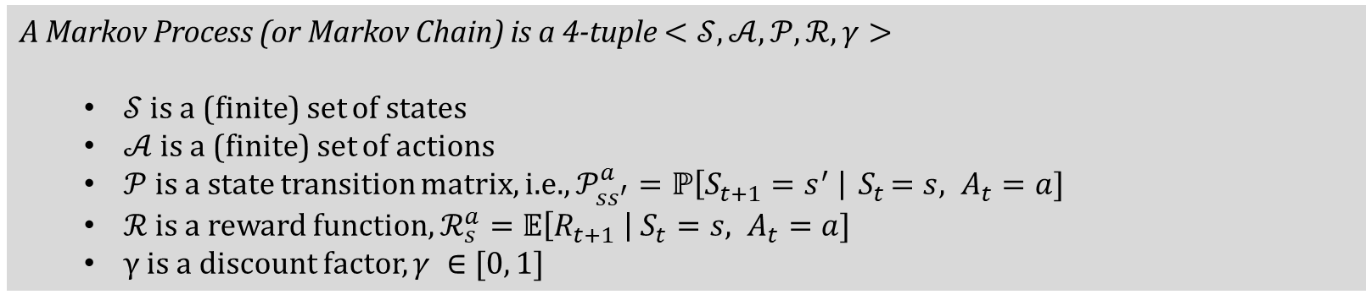
Markov Decision Process
A Markov decision process (MDP) is an environment in which all states are Markov and defined as follows
Definition
A Markov Process (or Markov Chain) is a 4-tuple $<𝒮, 𝒜,𝒫,ℛ, γ>$
$𝒮$ is a (finite) set of states
$𝒜$ is a (finite) set of actions
$𝒫$ is a state transition matrix, i.e., $𝒫_{ss^{′}}^{a}=ℙ\left[S_{t+1}=s^{′} \right|{ S}_{t}=s, A_{t}=a]$
$ℛ$ is a reward function, $ℛ_{s}^{a}=𝔼\left[R_{t+1} \right| S_{t}=s, A_{t}=a]$
γ is a discount factor, $γ ∈[0, 1]$
L. Brigato
Reinforcement Learning: Elementary RL

Slide 25
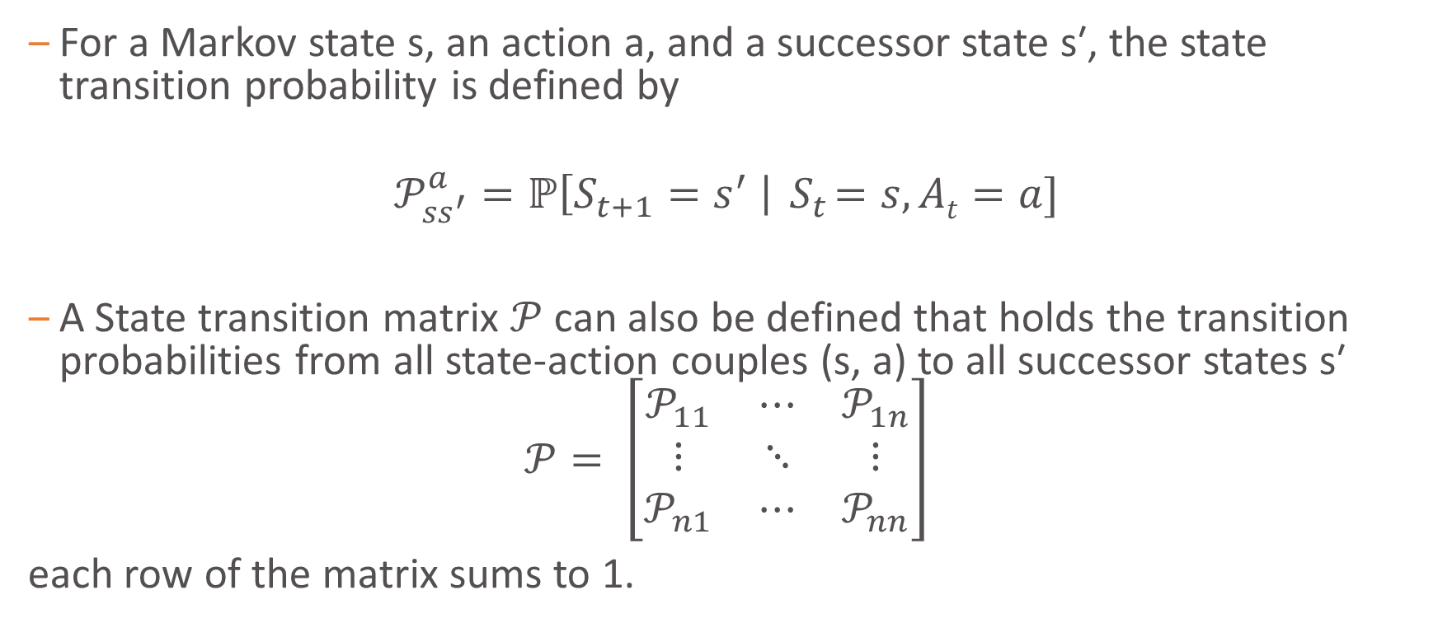
State Transition Matrix
For a Markov state s, an action a, and a successor state s′, the state transition probability is defined by
$$𝒫_{ss^{′}}^{a}=ℙ\left[S_{t+1}=s^{′} \right|{ S}_{t}=s,At=a]$$
A State transition matrix $𝒫$ can also be defined that holds the transition probabilities from all state-action couples (s, a) to all successor states s′
$$𝒫= \left[\begin{matrix}𝒫_{11} & ⋯ & 𝒫_{1n} \\ ⋮ & ⋱ & ⋮ \\ 𝒫_{n1} & ⋯ & 𝒫_{nn}\end{matrix}\right]$$
each row of the matrix sums to 1.
L. Brigato
Reinforcement Learning: Elementary RL

Slide 26
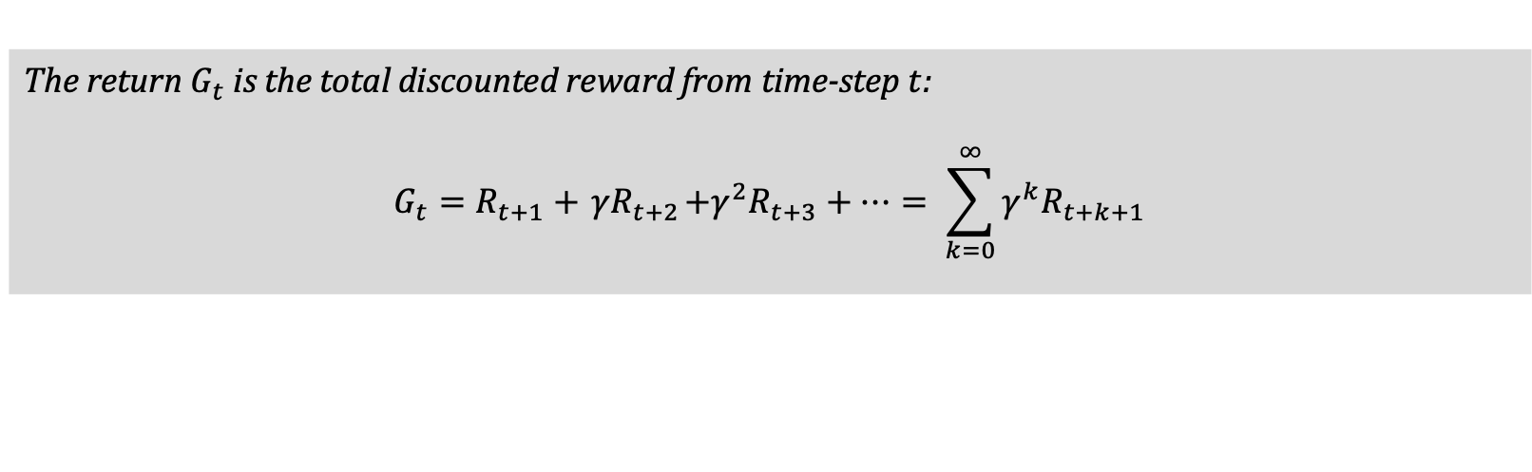
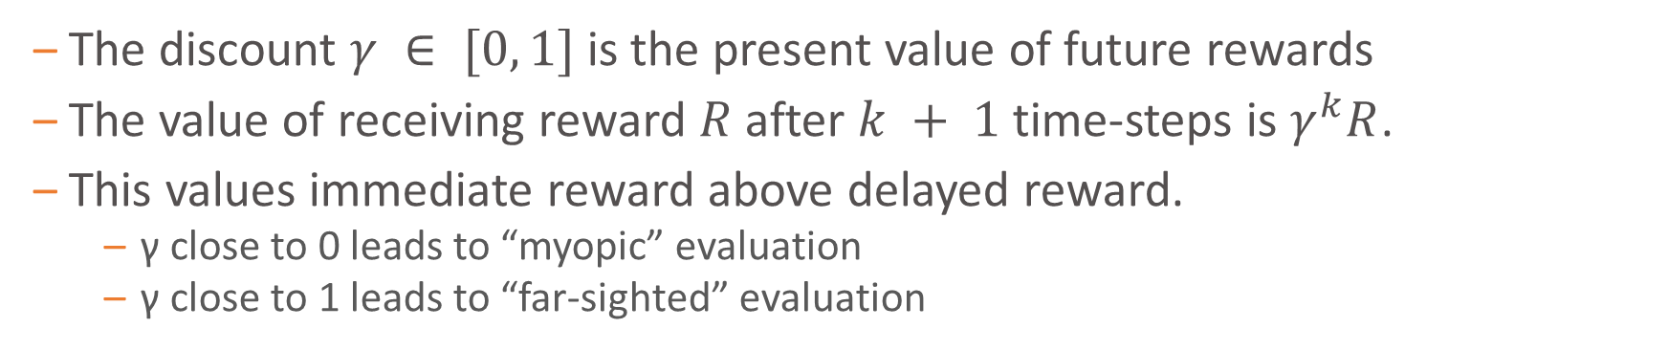
Return
Definition
The return $G_{t}$ is the total discounted reward from time-step $t$:
$$G_{t}=R_{t+1}+{ γR}_{t+2}+γ^{2}R_{t+3}+⋯= \sum_{k=0}^{∞}{γ^{k}R_{t+k+1}}$$
The discount $γ ∈ [0, 1]$is the present value of future rewards
The value of receiving reward $R$ after $k + 1$time-steps is $γ^{k}R$.
This values immediate reward above delayed reward.
γ close to 0 leads to “myopic” evaluation
γ close to 1 leads to “far-sighted” evaluation
L. Brigato
Reinforcement Learning: Elementary RL

Slide 27
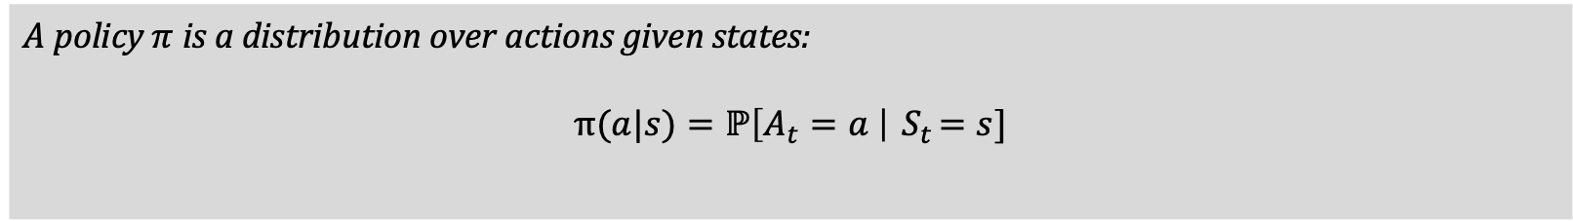
Policies (1/2)
Definition
A policy $π$ is a distribution over actions given states:
$$\text{π}(a|s)=ℙ\left[A_{t}=a \right|{ S}_{t}=s]$$
A policy fully defines the behaviour of an agent
MDP policies depend on the current state (not the history)
L. Brigato
Reinforcement Learning: Elementary RL

Slide 28
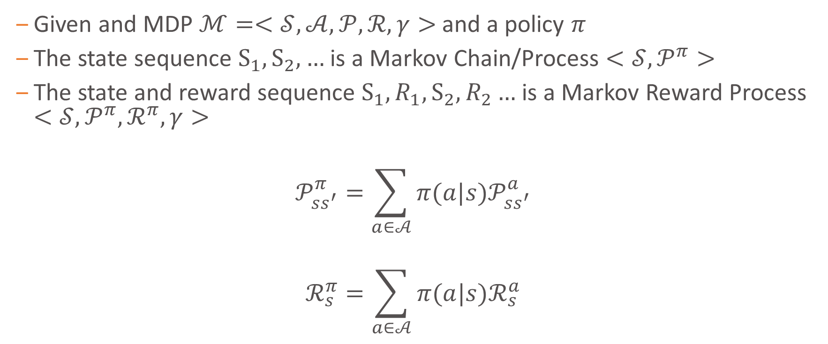
Policies (2/2)
Given and MDP $ℳ=<𝒮, 𝒜,𝒫,ℛ, γ>$ and a policy $π$
The state sequence $S_{1}, S_{2}, …$ is a Markov Chain/Process $<𝒮,𝒫^{π}>$
The state and reward sequence $S_{1},R_{1}, S_{2}, R_{2}…$ is a Markov Reward Process $<𝒮,𝒫^{π},ℛ^{π}, γ>$
$$𝒫_{ss^{′}}^{π}=\sum_{a∈𝒜}{π(a|s)𝒫_{ss^{′}}^{a}}$$
$$ℛ_{s}^{π}=\sum_{a∈𝒜}{π(a|s)ℛ_{s}^{a}}$$
L. Brigato
Reinforcement Learning: Elementary RL

Slide 29
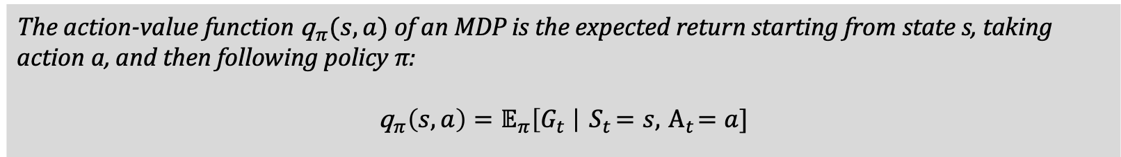
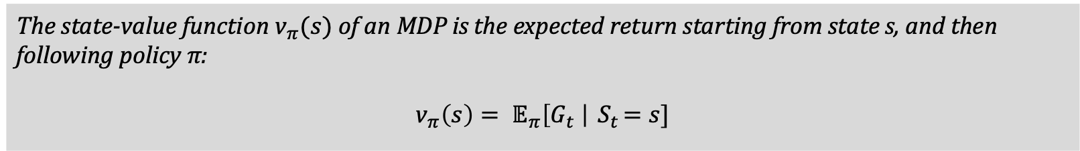
State-Value and Action-Value Functions
Definition
The state-value function ${\text{v}}_{π}(s)$ of an MDP is the expected return starting from state s, and then following policy π:
$${\text{v}}_{π}\left(s\right)= 𝔼_{π}\left[G_{t} \right|{ S}_{t}=s]$$
Definition
The action-value function ${\text{q}}_{π}(s,a)$ of an MDP is the expected return starting from state s, taking action a, and then following policy π:
$${\text{q}}_{π}\left(s,a\right)=𝔼_{π}\left[G_{t} \right|{ S}_{t}=s,{ Α}_{t}=a]$$
L. Brigato
Reinforcement Learning: Elementary RL

Slide 30
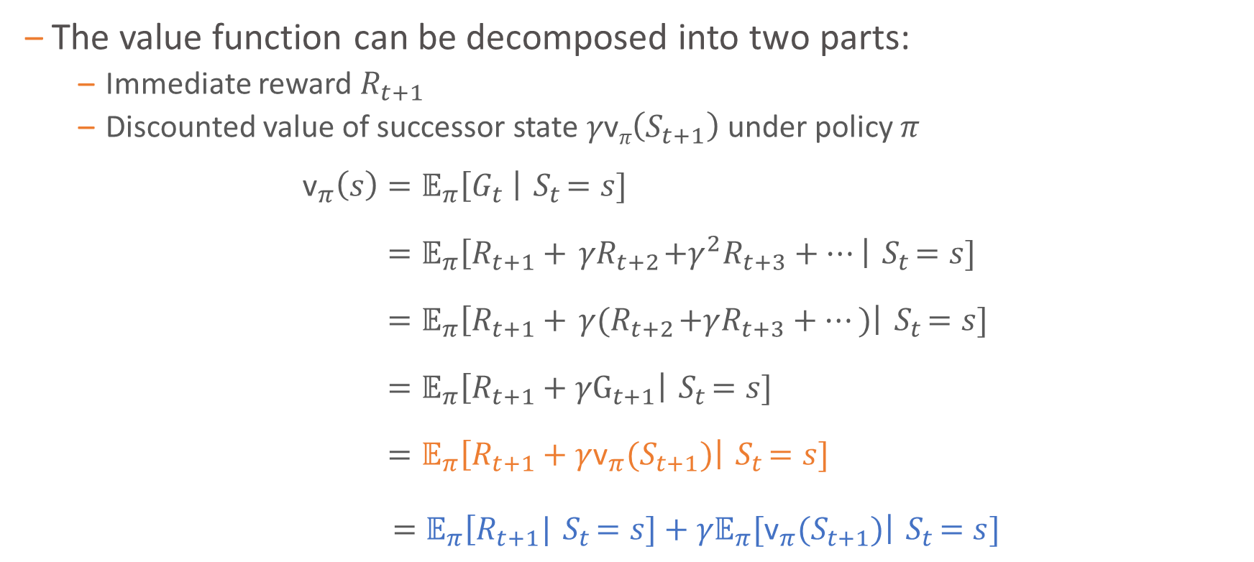
Bellman Expectation Equation
The value function can be decomposed into two parts:
Immediate reward $R_{t+1}$
Discounted value of successor state $γ\text{v}π\left(S_{t+1}\right)$ under policy $π$
$${\text{v}}_{π}\left(s\right)=𝔼_{π}\left[G_{t} \right|{ S}_{t}=s] \\ =𝔼_{π}\left[R_{t+1}+{ γR}_{t+2}+γ^{2}R_{t+3}+⋯\right|{ S}_{t}=s] \\ =𝔼_{π}\left[R_{t+1}+{ γ(R}_{t+2}+γR_{t+3}+⋯)\right|{ S}_{t}=s] \\ =𝔼_{π}\left[R_{t+1}+{ γG}_{t+1}\right|{ S}_{t}=s] \\ =𝔼_{π}\left[R_{t+1}+γ{\text{v}}_{π}(S_{t+1})\right|{ S}_{t}=s]$$
$=𝔼_{π}\left[R_{t+1}|{ S}_{t}=s]+{γ𝔼}_{π}[{\text{v}}_{π}(S_{t+1})\right|{ S}_{t}=s]$
L. Brigato
Reinforcement Learning: Elementary RL

Slide 31
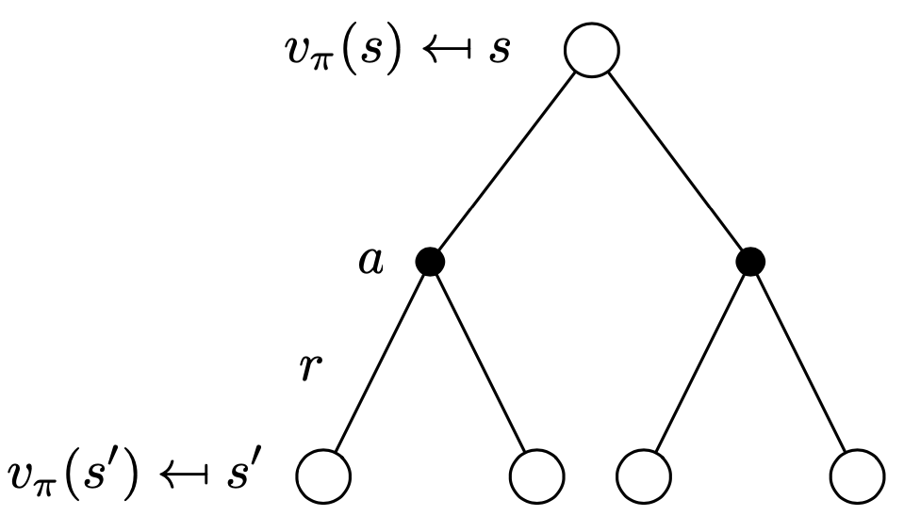
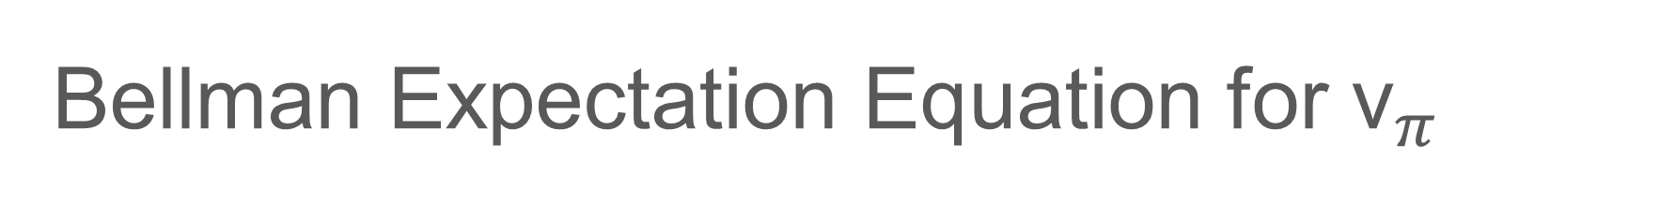
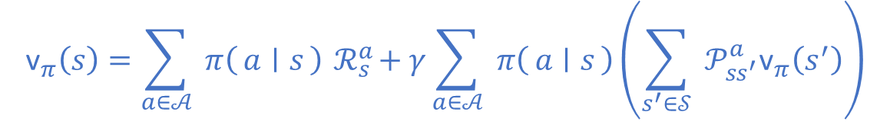
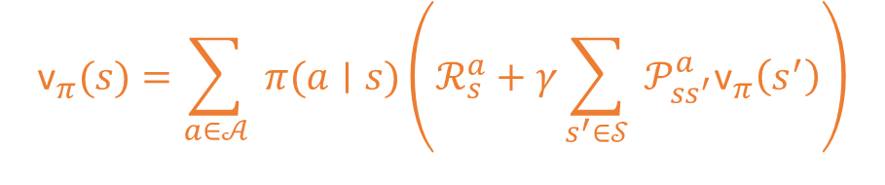
Bellman Expectation Equation for ${\text{v}}_{π}$
$${\text{v}}_{π}(s)=\sum_{a∈𝒜}{ }π(a∣s)\left(ℛ_{s}^{a}+γ\sum_{s^{′}∈𝒮}{ }𝒫_{ss^{′}}^{a}{\text{v}}_{π}\left(s^{′}\right)\right)$$
$${\text{v}}_{π}\left(s\right)=\sum_{a∈𝒜}{ }π\left(a ∣ s\right){ ℛ}_{s}^{a}+γ\sum_{a∈𝒜}{ }π\left(a ∣ s\right)\left(\sum_{s^{′}∈𝒮}{ }𝒫_{ss^{′}}^{a}{\text{v}}_{π}\left(s^{′}\right)\right)$$
L. Brigato
Reinforcement Learning: Elementary RL

Slide 32
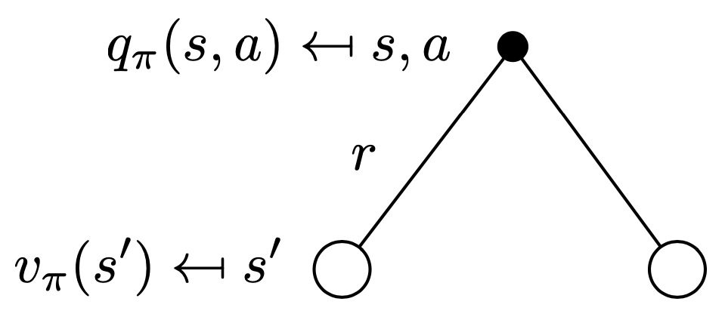
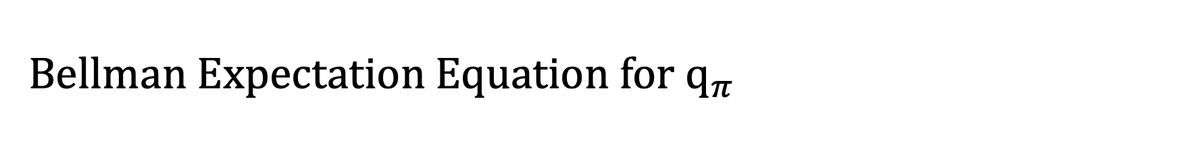

Bellman Expectation Equation for ${\text{q}}_{π}$
$$q_{π}(s,a)=ℛ_{s}^{a}+γ\sum_{s^{′}∈𝒮}{ }𝒫_{ss^{′}}^{a}{\text{v}}_{π}\left(s^{′}\right)$$
L. Brigato
Reinforcement Learning: Elementary RL

Slide 33
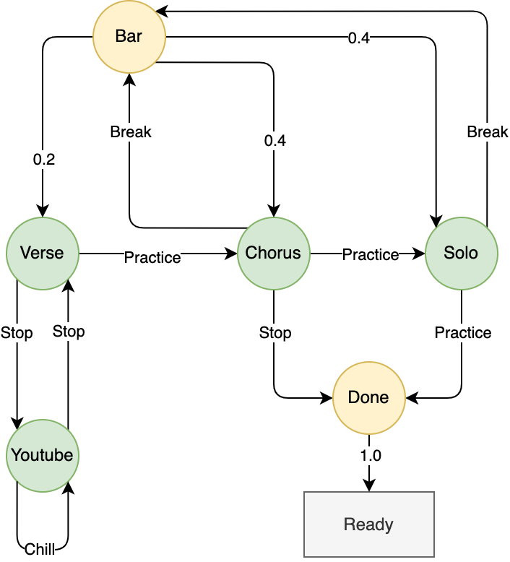
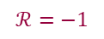
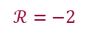
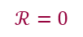
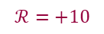
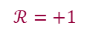
Example: Song Learning MDP
$$ℛ=+1$$
$$ℛ=−2$$
$$ℛ=−2$$
$$ℛ=−2$$
$$ℛ=+10$$
$$ℛ=−1$$
$$ℛ=0$$
L. Brigato
Reinforcement Learning: Elementary RL

Slide 34
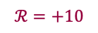
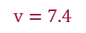
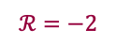
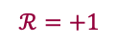
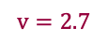
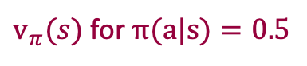
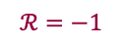
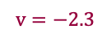
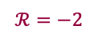
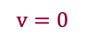
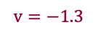
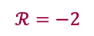
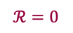
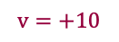
Example: Bellman Expectation Equation in MDP
$$ℛ=+1$$
$v_{π}(s)$for $π(a|s)=0.5$
$$ℛ=−2$$
$$ℛ=−2$$
$$ℛ=−2$$
$$v=−1.3$$
$$v=2.7$$
$$v=7.4$$
$$ℛ=+10$$
$$ℛ=−1$$
$$v=+10$$
$$v=−2.3$$
$$ℛ=0$$
$$v=0$$
L. Brigato
Reinforcement Learning: Elementary RL

Slide 35








Example: Bellman Expectation Equation in MDP
$$v_{π}=3.5$$
$$ℛ=+1$$
$v_{π}(s)$for $π(a|s)=0.5$
$$7.4 =0.5∗\left(1−0.2∗1.3 +0.4∗2.7+0.4∗7.4\right) \\ + 0.5∗10$$
$$ℛ=−2$$
$$ℛ=−2$$
$$ℛ=−2$$
$$v_{π} =−1.3$$
$$v_{π} =2.7$$
$$v_{π} =7.4$$
$$ℛ=+10$$
$$ℛ=−1$$
$$v_{π} =+10$$
$$v_{π} =−2.3$$
$$ℛ=0$$
$$v_{π} =0$$
L. Brigato
Reinforcement Learning: Elementary RL

Slide 36

Bellman Expectation Equation (Matrix Form)
The Bellman equation is a linear equation
$${\text{v}}_{π}=ℛ^{π}+γ𝒫^{π}\text{v}$$
It can be solved directly
$${\text{v}}_{π} ={(Ι −γ𝒫^{π})}^{−1}ℛ^{π}$$
Matrix Inversion is computational heavy $𝒪(n^{3})$
Direct solution only possible for small MDPs
There are many iterative methods for large MDPs, e.g.
Dynamic programming
Monte-Carlo evaluation
Temporal-Difference learning
L. Brigato
Reinforcement Learning: Elementary RL

Slide 37

Optimal Value Function
Definition
The optimal state-value function ${\text{v}}_{∗}(s)$ is the maximum value function over all policies
$${\text{v}}_{∗}(s)=\max_{π}{{\text{v}}_{π}(s)}$$
The optimal action-value function ${\text{q}}_{∗}(s,a)$ is the maximum action-value function over all policies
$${\text{q}}_{∗}(s,a)=\max_{π}{{\text{q}}_{π}(s,a)}$$
The optimal value function specifies the best possible performance in the MDP
An MDP is “solved” when we know the optimal value function
L. Brigato
Reinforcement Learning: Elementary RL

Slide 38
Prediction
38

Slide 39

Policy Evaluation
Goal: learn ${\text{v}}_{π}$ from episodes of experience under policy $π$
$$S_{1}{,A}_{1},R_{1},…{,S}_{k}\sim π$$
Recall: the return is the total discounted reward
$$G_{t}=R_{t+1}+{ γR}_{t+2}+γ^{2}R_{t+3}+⋯$$
Recall: the value function is the expected return:
$${\text{v}}_{π}(s)=𝔼_{π}\left[G_{t} \right|{ S}_{t}=s]$$
L. Brigato
Reinforcement Learning: Elementary RL

Slide 40
Policy Evaluation
Known MDP (model available)
Dynamic Programming
Unknown MDP (model not available)
Monte-Carlo Learning
Temporal-Difference Learning
N-step TD
L. Brigato
Reinforcement Learning: Elementary RL

Slide 41
What is Dynamic Programming?
Dynamic: sequential or temporal component to the problem
Programming: optimizing a “program”, i.e., a policy
A collection of algorithms to compute optimal policies/values given a known finite MDP.
This is achieved by breaking Bellman Equations into subproblems
Solve the subproblems
Combine solutions of subproblems
L. Brigato
Reinforcement Learning: Elementary RL

Slide 42

Iterative Policy Evaluation
Problem: evaluate a given policy $π$
Solution: iterative application of Bellman expectation update
$${\text{v}}_{1}→{\text{v}}_{2}→…→{\text{v}}_{π}$$
Using synchronous updates,
At each iteration $k + 1$
For all states $s ∈ 𝒮^{′}$
Update ${\text{v}}_{k+1}(s)$ from ${\text{v}}_{k}(s^{′})$
where s′ is a successor state of s
Convergence to ${\text{v}}_{π}$ is proven at a geometric rate (refer to Banach’s fixed-point theorem)
L. Brigato
Reinforcement Learning: Elementary RL

Slide 43

Dynamic Programming Update
$$V\left(S_{t}\right)←𝔼_{π}[R_{t+1}+γV(S_{t+1})]$$
[David Silver, IRL, UCL 2015]
L. Brigato
Reinforcement Learning: Elementary RL

Slide 44

Iterative Policy Evaluation in Small Gridworld (1/2)
[An Introduction to Reinforcement Learning, Sutton and Barto]
L. Brigato
Reinforcement Learning: Elementary RL

Slide 45

Iterative Policy Evaluation in Small Gridworld (2/2)
[An Introduction to Reinforcement Learning, Sutton and Barto]
L. Brigato
Reinforcement Learning: Elementary RL

Slide 46
Model-Free Policy Evaluation
Monte-Carlo (MC) Learning
MC methods learn from complete episodes of experience
Simplest possible idea: value = mean return
Caveat: can only apply MC to episodic MDPs
All episodes must terminate
Temporal-Difference (TD) Learning
TD methods learn from incomplete episodes of experience
TD learns from episodes, by bootstrapping (updates a guess towards a guess)
L. Brigato
Reinforcement Learning: Elementary RL

Slide 47

Incremental Mean
The mean $μ_{k}$ of a sequence $x_{1}$, $x_{2}$, ..., $x_{k}$ can be computed incrementally,
$$μ_{k}= \frac{1}{k}\sum_{i=1}^{k}{x_{i}} \\ =\frac{1}{k}\left(x_{k}+\sum_{i=1}^{k−1}{x_{i}}\right) \\ = \frac{1}{k} \left(x_{k}+\left(k−1\right)μ_{k−1}\right) \\ = μ_{k−1}+\frac{1}{k}(x_{k}−μ_{k−1})$$
L. Brigato
Reinforcement Learning: Elementary RL

Slide 48


MC Incremental Update
Update $V(s)$ incrementally after episode $S_{1}{,A}_{1},R_{1},…{,S}_{k}$
For each state $S_{t}$ with return $G_{t}$ and number of visits $N\left(S_{t}\right)$:
Update state value
$V\left(S_{t}\right)←V\left(S_{t}\right)+ \frac{1}{N\left(S_{t}\right)}(G_{t}−V\left(S_{t}\right))$
Update visit count
$N\left(s\right)←N\left(s\right)+1$
[David Silver, IRL, UCL 2015]
L. Brigato
Reinforcement Learning: Elementary RL

Slide 49


TD Incremental Update
Update $V(s)$ incrementally after transition $S_{t}{,A}_{t},R_{t+1},$ $S_{t+1}$
For each state $S_{t}$ with reward $R_{t+1}$:
Update state value toward estimated return $R_{t+1}+γV(S_{t+1})$
$V\left(S_{t}\right)←V\left(S_{t}\right)+α(R_{t+1}+γV(S_{t+1})−V\left(S_{t}\right))$
$R_{t+1}+γV(S_{t+1})$ is called TD target
${δ_{t}= R}_{t+1}+γV\left(S_{t+1}\right)−V\left(S_{t}\right)$ is called the TD error
[David Silver, IRL, UCL 2015]
L. Brigato
Reinforcement Learning: Elementary RL

Slide 50

Bias/Variance Trade-Off
$G_{t}=R_{t+1}+{ γR}_{t+2}+γ^{2}R_{t+3}+⋯$ is an unbiased estimate of the ${\text{v}}_{π}$
True TD target $R_{t+1}+γ{\text{v}}_{π}(S_{t+1})$ is unbiased estimate of ${\text{v}}_{π}$
The TD target $R_{t+1}+γV(S_{t+1})$ is a biased estimate of ${\text{v}}_{π}$
TD target is much lower variance than the return:
Return depends on many random actions, transitions, rewards
TD target depends on one random action, transition, reward
L. Brigato
Reinforcement Learning: Elementary RL

Slide 51


Example: Driving Home
[An Introduction to Reinforcement Learning, Sutton and Barto]
L. Brigato
Reinforcement Learning: Elementary RL

Slide 52

MC vs TD
TD can learn before/without knowing the outcome
MC doesn’t exploit Markov property
Usually more effective in non-Markov environments
MC has high variance, zero bias
Good convergence properties
Not very sensitive to initial value
Very simple to understand and use
TD has low variance, some bias
Usually more efficient than MC
TD(0) converges to ${\text{v}}_{π}\left(s\right)$
More sensitive to initial value
L. Brigato
Reinforcement Learning: Elementary RL

Slide 53

Unified View of Reinforcement Learning
Bootstrapping: update involves an estimate
MC does not bootstrap
DP bootstraps
TD bootstraps
Sampling: update samples an expectation
MC samples
DP does not sample
TD samples
[An Introduction to Reinforcement Learning, Sutton and Barto]
L. Brigato
Reinforcement Learning: Elementary RL

Slide 54
Control
54

Slide 55

How to Improve a Policy
Given a policy $π$
Evaluate the policy $π$
${\text{v}}_{π}\left(s\right)= 𝔼_{π}\left[R_{t+1}+{ γR}_{t+2}+γ^{2}R_{t+3}+⋯\right|{ S}_{t}=s]$
Improve the policy by acting greedily with respect to ${\text{v}}_{π}$
$π^{′}=greedy({\text{v}}_{π})$
In Small Gridworld improved policy was optimal, $π^{′}=π^{∗}$
In general, need more iterations of improvement/evaluation
But this process of policy iteration always converges to π∗ (deterministic environments)
L. Brigato
Reinforcement Learning: Elementary RL

Slide 56



Policy Iteration
Policy evaluation Estimate ${\text{v}}_{π}$
Iterative policy evaluation
Policy improvement Generate $π′ ≥ π$
Greedy policy improvement
[An Introduction to Reinforcement Learning, Sutton and Barto]
L. Brigato
Reinforcement Learning: Elementary RL

Slide 57
Model-Free Control
Some problems can’t be tackled with DP:
MDP model is unknown, but experience can be sampled
MDP model is known, but is too big to use, except by samples
Model-free control can solve these problems
L. Brigato
Reinforcement Learning: Elementary RL

Slide 58

On and Off-Policy Learning
On-policy learning
“Learn on the job”
Learn about policy $π$ from experience sampled from $π$
Off-policy learning
“Look over someone’s shoulder”
Learn about policy $π$ from experience sampled from $μ$
L. Brigato
Reinforcement Learning: Elementary RL

Slide 59

Generalized Policy Iteration for Monte-Carlo
Policy evaluation
Monte-Carlo policy evaluation, V = ${\text{v}}_{π}$ ?
Policy improvement
Greedy policy improvement ?
[An Introduction to Reinforcement Learning, Sutton and Barto]
L. Brigato
Reinforcement Learning: Elementary RL

Slide 60

Model-Free Policy Iteration Using Action-Value Function
Greedy policy improvement over $V(s)$ requires model of MDP
$$π^{′}\left(s\right)= \underset{a∈𝒜}{argmax}\left[ℛ_{s}^{a}+𝒫_{ss^{′}}^{a}V(s^{′})\right]$$
Greedy policy improvement over $Q(s,a)$is model-free
$$π^{′}\left(s\right)= \underset{a∈𝒜}{argmax}{Q(s,a)}$$
L. Brigato
Reinforcement Learning: Elementary RL

Slide 61



Generalized Policy Iteration with Action-Value Function
Policy evaluation
Monte-Carlo policy evaluation, Q = ${\text{q}}_{π}$
Policy improvement
Greedy policy improvement ?
[David Silver, IRL, UCL 2015]
[An Introduction to Reinforcement Learning, Sutton and Barto]
L. Brigato
Reinforcement Learning: Elementary RL

Slide 62

ε-Greedy Exploration
Simplest idea for ensuring continual exploration
All actions are tried with non-zero probability
With probability $1 − ε$ choose the greedy action
With probability $ε$ choose an action at random
$$π\left(a ∣ s\right)=\left\{\begin{matrix}ε/m+1−ε & ,if a^{∗}=\underset{a∈𝒜}{argmax}{Q(s,a)} \\ ε/m & ,otherwise \end{matrix}\right.$$
L. Brigato
Reinforcement Learning: Elementary RL

Slide 63


Monte-Carlo Policy Iteration
Policy evaluation
Monte-Carlo policy evaluation, Q = ${\text{q}}_{π}$
Policy improvement
ε-Greedy policy improvement
[David Silver, IRL, UCL 2015]
L. Brigato
Reinforcement Learning: Elementary RL

Slide 64


Monte-Carlo Control
Every episode:
Policy evaluation
Monte-Carlo policy evaluation, $Q≈q_{π}$
Policy improvement
ε-Greedy policy improvement
L. Brigato
Reinforcement Learning: Elementary RL

Slide 65

GLIE Monte-Carlo Control
Sample kth episode using $π:\{S_{1},A_{1},R_{2},…,S_{T}\}\sim π$
For each state $S_{t}$ and action $A_{t}$ in the episode,
$$N\left(S_{t},A_{t}\right)←N\left(S_{t},A_{t}\right)+1 \\ Q\left(S_{t},A_{t}\right)←Q\left(S_{t},A_{t}\right)+\frac{1}{N\left(S_{t},A_{t}\right)}(G_{t}−Q\left(S_{t},A_{t}\right))$$
Improve policy based on new action-value function
$$ε←1/k \\ π←ε−greedy(Q)$$
Theorem
GLIE Monte-Carlo control converges to the optimal action-value function, $Q(s,a)→q_{∗}(s,a)$
L. Brigato
Reinforcement Learning: Elementary RL

Slide 66

MC vs. TD Control
Temporal-difference (TD) learning has several advantages over Monte-Carlo (MC)
Lower variance
Online
Incomplete sequences
Natural idea: use TD instead of MC in our control loop
Apply TD to $Q(S, A)$
Use ε-greedy policy improvement
Update every time-step
L. Brigato
Reinforcement Learning: Elementary RL

Slide 67

Updating Action-Value Functions with Sarsa
$$Q\left(S,A\right)←Q\left(S,A\right)+α(R+γQ\left(S^{′},A^{′}\right)−Q(S,A))$$
[David Silver, IRL, UCL 2015]
L. Brigato
Reinforcement Learning: Elementary RL

Slide 68

Sarsa Algorithm for On-Policy Control
[An Introduction to Reinforcement Learning, Sutton and Barto]
L. Brigato
Reinforcement Learning: Elementary RL

Slide 69

Off-Policy Learning
Evaluate target policy $π(a|s)$ to compute ${\text{v}}_{π}(s)$ or ${\text{q}}_{π}\left(s,a\right)$
While following behavior policy $μ\left(a | s\right)$
$$\{S_{1},A_{1},R_{2},…,S_{T}\}\sim μ$$
Why is this important?
Learn from observing humans or other agents
Re-use experience generated from old policies $π_{1},π_{2},…,π_{t−1}$
Learn about optimal policy while following exploratory policy
Learn about multiple policies while following one policy
L. Brigato
Reinforcement Learning: Elementary RL

Slide 70

Off-Policy Control with Q-Learning
We now allow both behavior and target policies to improve
The target policy $π$ is greedy w.r.t. $Q(s,a)$
$$π\left(S_{t+1}\right)= \underset{a^{′}}{argmax}{Q(S_{t+1},a^{′})}$$
The behavior policy $μ$ is e.g., ε-greedy w.r.t. $Q(s,a)$
The Q-learning target then simplifies:
$$R_{t+1}+γQ\left(S_{t+1},A^{′}\right) \\ =R_{t+1}+γQ\left(S_{t+1},\underset{a^{′}}{argmax}{Q(S_{t+1},a^{′})}\right) \\ =R_{t+1}+\underset{a^{′}}{γ max}{Q(S_{t+1},a^{′}})$$
L. Brigato
Reinforcement Learning: Elementary RL

Slide 71

Q-Learning Control Algorithm
$$Q\left(S,A\right)←Q\left(S,A\right)+α(R_{t+1}+\underset{a^{′}}{γ max}{Q(S^{′},a^{′}})−Q\left(S,A\right))$$
[David Silver, IRL, UCL 2015]
L. Brigato
Reinforcement Learning: Elementary RL

Slide 72

Q-Learning Algorithm for Off-Policy Control
[An Introduction to Reinforcement Learning, Sutton and Barto]
L. Brigato
Reinforcement Learning: Elementary RL

Slide 73


Example: Cliff Walking
L. Brigato
Reinforcement Learning: Elementary RL

